Slide 1
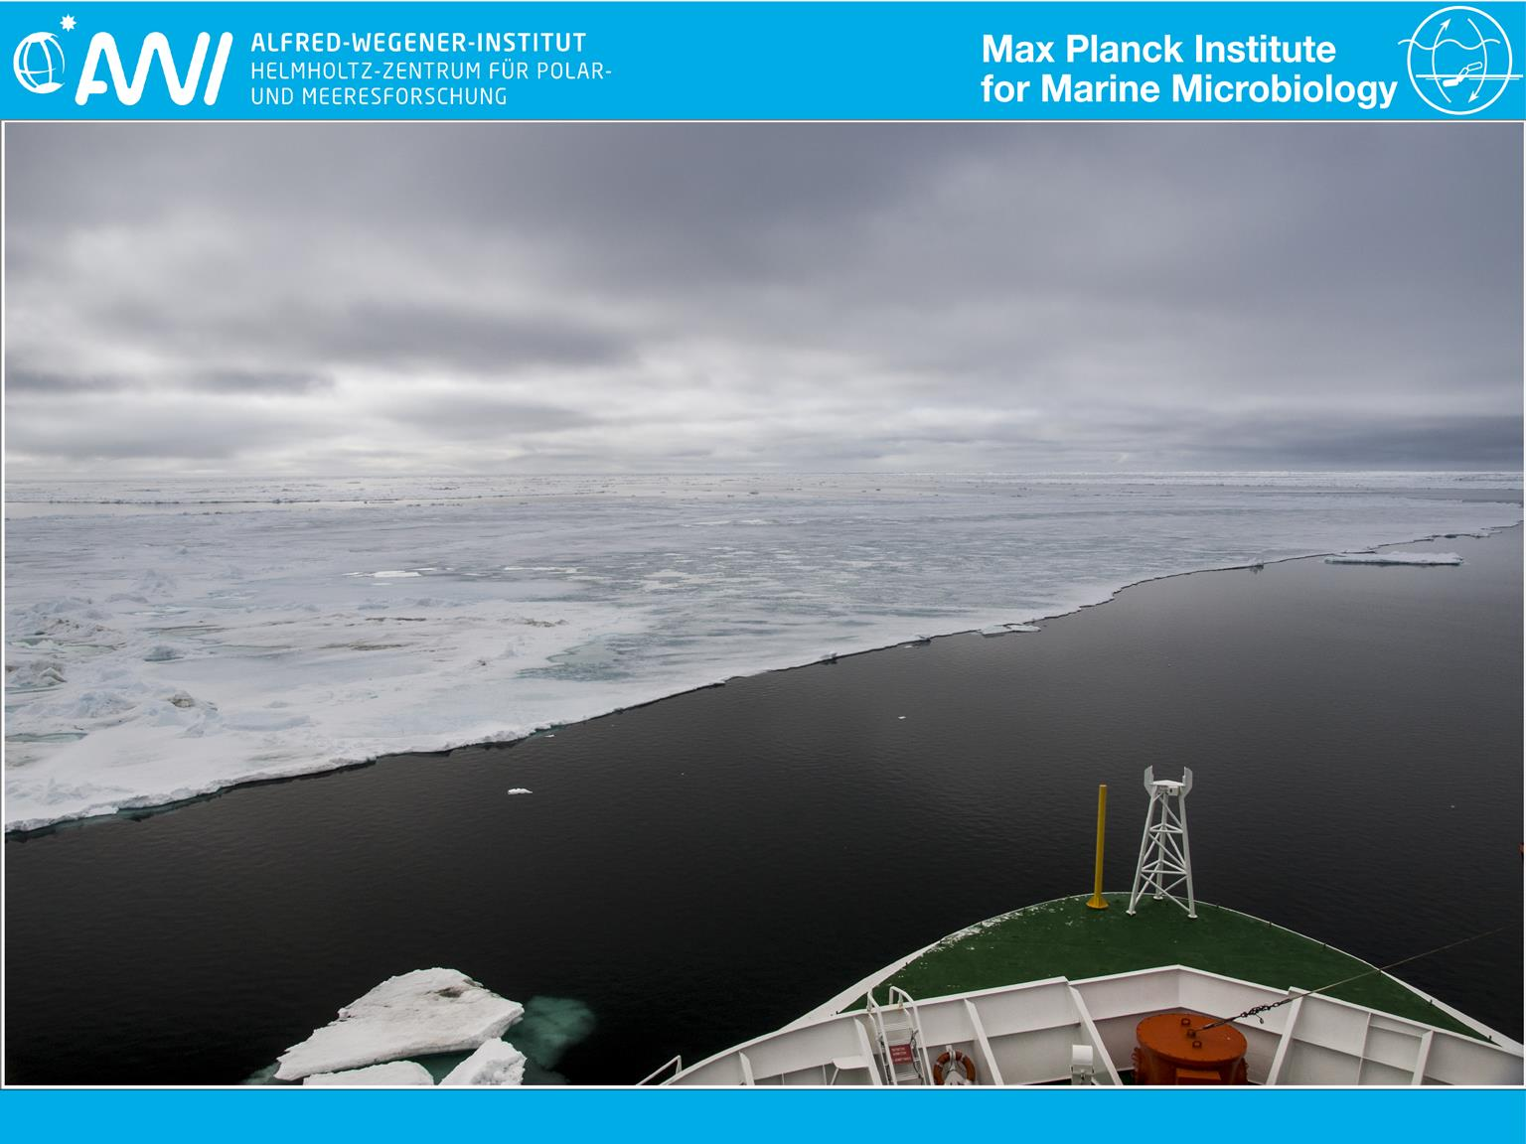
Interconnecting Arctic observatory data through machine-actionable knowledge representation: are ontologies fit for purpose?
Kai Blumberg
Supervisor: Dr. Pier Luigi Buttigieg
Group leader: Prof. Dr. Antje Boetius
Image courtesy of Fadeev et al, 2016: Towards an integrated microbial observatory in the Arctic Ocean 10013/epic.49869. d001
1
Notes:
1

Slide 2

Wilderness of data
1
01010111
11
11
110011001
log.txt
11
ARX_343_R.FASTA
10
01
Test.csv
TGACGTTACGGTGATCGATTCGCC
Cruise_1_01.01.14.xlsx
10100001010100100010010010100100101010101100010100101001001001001001001
010
110
010
1
10
10
S1_01.NetCDF
010
10
110
Testfile_X.CSV
110011
010010110101001011
Notes:
Show data files shape files netcdf csv etc with 10’s show in different textfile x or test 1, that’s the wilderness of data not domesticated.

Slide 3
Motivation: FAIR data
Findable Accessible Interoperable Reusable
Interoperable data:
formal, accessible, shared, and broadly applicable vocabularies for knowledge representation
Wilkinson et al. (2016) Scientific Data. 3:160018.
3
Notes:
People have recognized the need to tame the wilderness of data
FAIR, Thessen et al, Wall et al 2014

Slide 4
Motivation: FAIR data
Interoperable data:
formal, accessible, shared, and broadly applicable vocabularies for knowledge representation
Overcome barriers to data discovery & integration
“Can we gather all metagenomes collected from insects found in soil?”
Wilkinson et al. (2016) Scientific Data. 3:160018.
Walls et al. (2014) PLoS ONE. 9(3): e89606.
4
Notes:
People have recognized the need to tame the wilderness of data
FAIR, Thessen et al, Wall et al 2014

Slide 5
Motivation: FAIR data
Interoperable data:
formal, accessible, shared, and broadly applicable vocabularies for knowledge representation
Overcome barriers to data discovery & integration
“Can we gather all metagenomes collected from insects found in soil?”
Linking phenotypes and environments:
“Which crop varieties are expected to do well in a particular location over the next century?”
Wilkinson et al. (2016) Scientific Data. 3:160018.
Walls et al. (2014) PLoS ONE. 9(3): e89606.
Thessen et al. (2015) PeerJ. 3:e1470
5
Notes:
People have recognized the need to tame the wilderness of data
FAIR, Thessen et al, Wall et al 2014

Slide 6
Wilderness of data
1
01010111
11
11
110011001
log.txt
11
ARX_343_R.FASTA
10
01
Test.csv
TGACGTTACGGTGATCGATTCGCC
Cruise_1_01.01.14.xlsx
10100001010100100010010010100100101010101100010100101001001001001001001
010
110
010
1
10
10
S1_01.NetCDF
010
10
110
Testfile_X.CSV
110011
010010110101001011
Notes:
Show data files shape files netcdf csv etc with 10’s show in different textfile x or test 1, that’s the wilderness of data not domesticated.

Slide 7
Taming the wilderness
1
01010111
11
11
110011001
Sea_ice_plankton.FASTA
genome_log.txt
10
11
01
irradiance.csv
TGACGTTACGGTGATCGATTCGCC
Inorganic_nutrients.xlsx
10100001010100100010010010100100101010101100010100101001001001001001001
010
110
010
1
10
10
010
10
110
Chlorophyll_a.CSV
Satelite_chlorophyll.NetCDF
110011
010010110101001011
Notes:
7
It would be an improvement to know what the data is about -> question how do we connect data and info to knowledge about what it is the real world so machines can understand it.
Tame wild by telling computer system what data is about

Slide 8

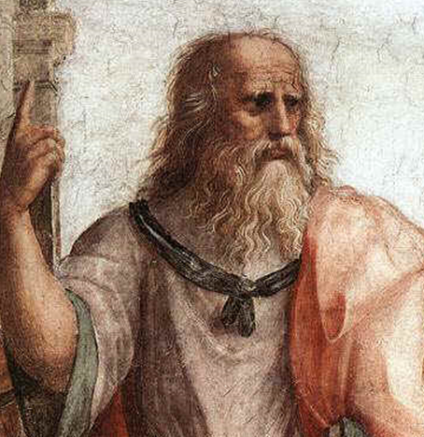
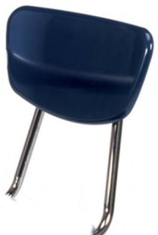

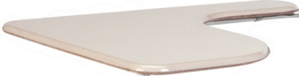
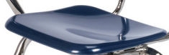
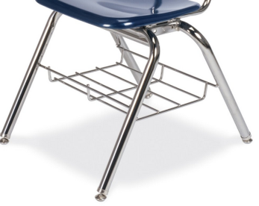
Ontology
~ def. A machine- and human-readable, logical representation of expert knowledge about real-world entities
thing
association
associated thing
Notes:
Introduce what an ontology is
There is a well established way to help machines get a naive understanding of the real world by showing it what things are based on its associations to other things. Web of association encode filed ontology, branch of metaphysical classification of things in the world and how they relate to one another, practical to way explain what we mean when we ID things to machines. Knowledge map, basically a knowledge map, good ones conducive to machines navigating by simulating what humans know about data.

Slide 9


Ontology
~ def. A machine- and human-readable, logical representation of expert knowledge about real-world entities
Knowledge graph
Notes:
Introduce what an ontology is
There is a well established way to help machines get a naive understanding of the real world by showing it what things are based on its associations to other things. Web of association encode filed ontology, branch of metaphysical classification of things in the world and how they relate to one another, practical to way explain what we mean when we ID things to machines. Knowledge map, basically a knowledge map, good ones conducive to machines navigating by simulating what humans know about data.

Slide 10


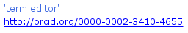
+
Notes:
10
Title adding knowledge to ontologies
Before taming need to get knowledge out human head into a system machines can process/navigate /understand

Slide 11
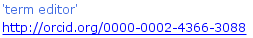
+
Notes:
11

Slide 12
Trace knowledge overlaps
Resolve discrepancies
?
+
Notes:
12
Finish knowledge graph conversation for next slide, can use it to tame the datascape.

Slide 13
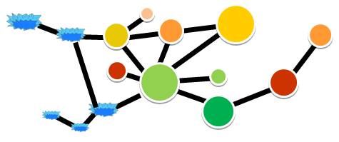

Ontology knowledge
+
Ontology annotation term(s)
Wild CSV file:
column
Tamed CSV file:
0
col
1
0
Tamed CSV column:
0
1
0
…
…
0
1
0
Notes:
Task to connect ontologies to data wilderness , we can tame the wildness more figurative version of this for intro, a different version for the methods
Ontology knowledge -> used to tame data via annotation, csv about …, csv column about …

Slide 14
?
Notes:
14
In a sense it’s similar to asking a supervisor for their collaborator network's data about x

Slide 15
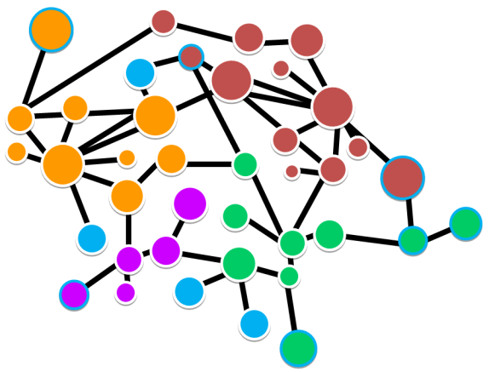


?
Notes:
15
Don’t have human expertise access, want knowledge based search functions. Not as tailored as a real supervisor but lets people navigate knowledge graph contributed by 100’s of people. Like Google vs. librarian
Semi automate the process data is too big for any one person to know. Build on this to show the datasets being delivered

Slide 16
Are ontologies fit for purpose to navigate an ecological knowledge and data-space?
Evaluate with
competency questions
Notes:
Aims of thesis, what do I mean by fit for purpose, to navigate the knowledge and dataspace, in order to do that in semantic research test ccs can it do this …
Show list of cc tested form may angles, highlight the ones I’m going to talk about. Another slide for the ccs I address, go from section with the cc in bold. As table of contents.

Slide 17
Are ontologies fit for purpose to navigate an ecological knowledge and data-space?
Evaluate with
competency questions
Test interaction of knowledge graph and data sets
Notes:
Aims of thesis, what do I mean by fit for purpose, to navigate the knowledge and dataspace, in order to do that in semantic research test ccs can it do this …
Show list of cc tested form may angles, highlight the ones I’m going to talk about. Another slide for the ccs I address, go from section with the cc in bold. As table of contents.

Slide 18
Are ontologies fit for purpose to navigate an ecological knowledge and data-space?
Evaluate with
Q1) What are the relative proportions of oxidation-reduction process genes in marine biomes?
Q2) What biological processes differentiate marine benthic biomes?
Q3) What cellular amino acid biosynthetic processes differentiate marine benthic biomes?
Q4) What serine family amino acid biosynthetic processes differentiate marine benthic biomes?
competency questions
Test interaction of knowledge graph and data sets
Notes:
Aims of thesis, what do I mean by fit for purpose, to navigate the knowledge and dataspace, in order to do that in semantic research test ccs can it do this …
Show list of cc tested form may angles, highlight the ones I’m going to talk about. Another slide for the ccs I address, go from section with the cc in bold. As table of contents.

Slide 19

+
data1:
data2:
data3:
data4: …
col
col
col
col
0
0
0
0
1
1
1
1
0
0
0
0
…
…
…
…
Notes:
Schema for ENVO and GO need to merge them connect to data holdings

Slide 20
+
Interaction of ontology knowledge graph
data1:
data2:
data3:
data4: …
col
col
col
col
0
0
0
0
1
1
1
1
0
0
0
0
…
…
…
…
Notes:
Schema for ENVO and GO need to merge them connect to data holdings

Slide 21
+
With example datasets
data1:
data2:
data3:
data4: …
col
col
col
col
0
0
0
0
1
1
1
1
0
0
0
0
…
…
…
…
Notes:
Schema for ENVO and GO need to merge them connect to data holdings

Slide 22
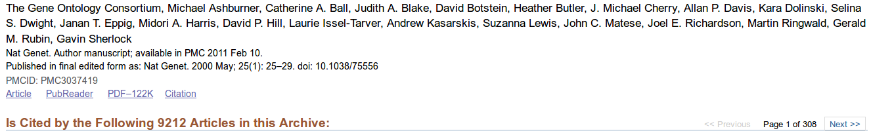
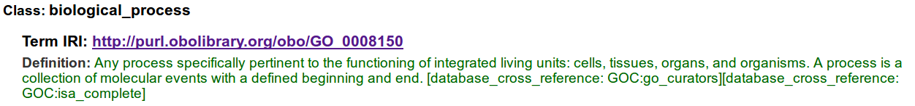
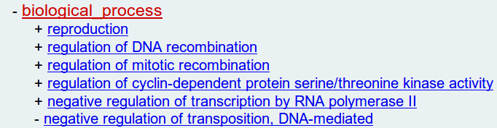
…
Notes:
22

Slide 23
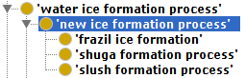
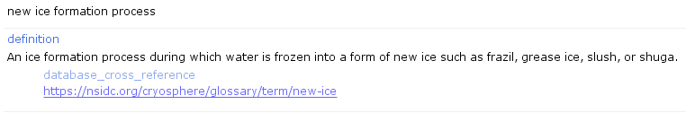
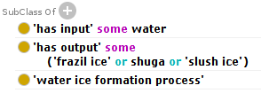
Notes:
23
Knowledge graphs aren’t just picture, engineered with controlled axioms, controlled by another ontology RO -> bring in AI angle, there are AI agents reasoners which check graphs, RO thoroughly checked by logicians,
Take opportunity to show the guts of these to engineer this knowledge have a view diagram (simple first), then simple diagram, then zoom out diagram more complexities, -> semantic science research seeing if our captures of human knowledge withstand AI checks, run test see if
After 3 versions repeat the envo/go /data slide, take a step back we talked about the first two , now we’ll talk about the 3rd part the data that’s been linked.

Slide 24
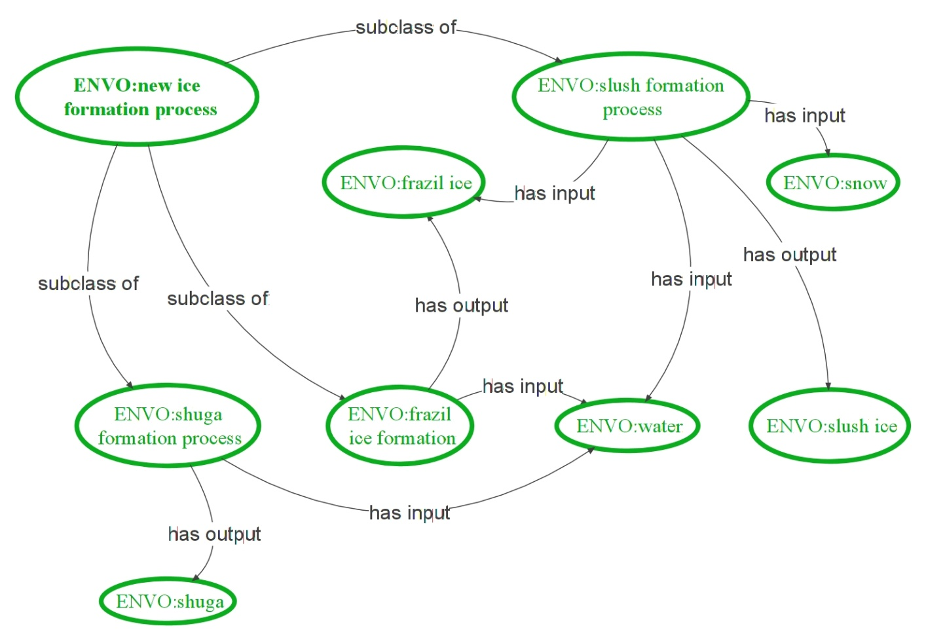
Notes:
24
Knowledge graphs aren’t just picture, engineered with controlled axioms, controlled by another ontology RO -> bring in AI angle, there are AI agents reasoners which check graphs, RO thoroughly checked by logicians,
Take opportunity to show the guts of these to engineer this knowledge have a view diagram (simple first), then simple diagram, then zoom out diagram more complexities, -> semantic science research seeing if our captures of human knowledge withstand AI checks, run test see if
After 3 versions repeat the envo/go /data slide, take a step back we talked about the first two , now we’ll talk about the 3rd part the data that’s been linked.

Slide 25

+
data1:
data2:
data3:
data4: …
col
col
col
col
0
0
0
0
1
1
1
1
0
0
0
0
…
…
…
…
Notes:
REPEAT OF Schema for ENVO and GO need to merge them connect to data holdings checked off the GO and ENVO parts. Now address the dataholdings

Slide 26
+
data1:
data2:
data3:
data4: …
col
col
col
col
0
0
0
0
1
1
1
1
0
0
0
0
…
…
…
…
Notes:
REPEAT OF Schema for ENVO and GO need to merge them connect to data holdings checked off the GO and ENVO parts. Now address the dataholdings

Slide 27
+
Annotate example datastore with ontology terms
data1:
data2:
data3:
data4: …
col
col
col
col
0
0
0
0
1
1
1
1
0
0
0
0
…
…
…
…
Notes:
REPEAT OF Schema for ENVO and GO need to merge them connect to data holdings checked off the GO and ENVO parts. Now address the dataholdings

Slide 28
Ontology knowledge
CSV file:
column
0
1
0
…
Notes:
Task to connect ontologies to data wilderness , we can tame the wildness more figurative version of this for intro, a different version for the methods
Ontology knowledge -> used to tame data via annotation, csv about …, csv column about …
Methods version after research problem
More detailed annotation slide
Dataholding I’ve put together
Ontology datastore

Slide 29
Ontology knowledge
is
about
CSV file:
column
0
1
0
…
first year ice
Notes:
Task to connect ontologies to data wilderness , we can tame the wildness more figurative version of this for intro, a different version for the methods
Ontology knowledge -> used to tame data via annotation, csv about …, csv column about …
Methods version after research problem
More detailed annotation slide
Dataholding I’ve put together
Ontology datastore

Slide 30
Ontology knowledge
is
about
CSV file:
column
0
1
0
is
about
…
first year ice
thickness
of
snow
Notes:
Task to connect ontologies to data wilderness , we can tame the wildness more figurative version of this for intro, a different version for the methods
Ontology knowledge -> used to tame data via annotation, csv about …, csv column about …
Methods version after research problem
More detailed annotation slide
Dataholding I’ve put together
Ontology datastore

Slide 31
?
Data about
Sea ice
Sea ice
Sea ice
Notes:
31
Lets interrogate test our research questions are they fit for purpose after all the knowledge rep research cycle, engineered the backend solution, can test the fitness for purpose question.

Slide 32
?
Omics Data
TCGAT
ATCG
TCGAT
Notes:
32
There’s no data about genomic variation in ice that’s readily accessible for analysis, however because these ontologies have been constructed to be general purpose, collective knowledge model I could switch to something else and still do this.

Slide 33
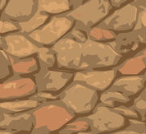
?
Omics Data
TCGAT
TCGAT
ATCG
Notes:
33
Already a sediment and depth biome hierarchy, could switch over and proceed
Resilience of the solution

Slide 34
?
TCGAT
TCGAT
ATCG
Courtesy of Josephine Z. Rapp.
Courtesy of David Probandt
Notes:
34
Reflect the go/envo/ sediment relations in the graph at some point explain the pfam to go, need to exampling link gen info to GO,
GO is not a mystery many of you have seen GO,
this is what it means when you have a GO term, GO terms not just another annotation, allows you to use these in your solutions.

Slide 35
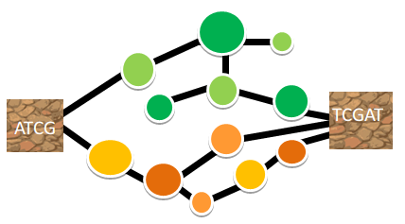
Q1) “What are the relative proportions of oxidation-reduction processes in marine benthic biomes?”
?
Notes:
35
*note this applies only for marine benthic biomes for which we have examples present in the dataholdings
Q1) What are the relative proportions of oxidation-reduction process genes in marine biomes?

Slide 36
36
Notes:
When I do that, show the finding this is doing all these things. Solution discovers the subclasses of ENVO… I didn’t know where they fit, using knowledge rep for knowledge for data discovery,

Slide 37
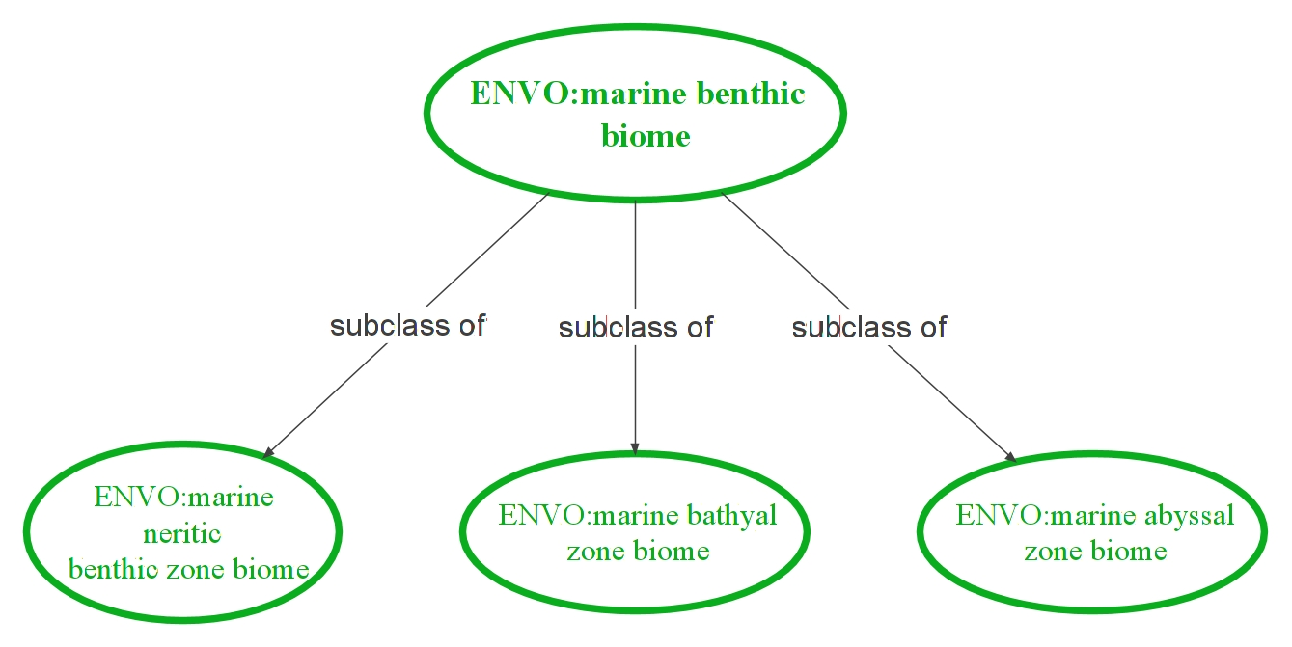
37
Notes:
When I do that, show the finding this is doing all these things. Solution discovers the subclasses of ENVO… I didn’t know where they fit, using knowledge rep for knowledge for data discovery,

Slide 38
38
Notes:
When I do that, show the finding this is doing all these things. Solution discovers the subclasses of ENVO… I didn’t know where they fit, using knowledge rep for knowledge for data discovery,

Slide 39
39
Notes:
When I do that, show the finding this is doing all these things. Solution discovers the subclasses of ENVO… I didn’t know where they fit, using knowledge rep for knowledge for data discovery,

Slide 40
Genomic sequences annotated with protein family (Pfam domains)
40
Notes:
When I do that, show the finding this is doing all these things. Solution discovers the subclasses of ENVO… I didn’t know where they fit, using knowledge rep for knowledge for data discovery,

Slide 41
Genomic sequences annotated with protein family (Pfam domains)
Pfam domains converted into corresponding GO terms
41
Notes:
When I do that, show the finding this is doing all these things. Solution discovers the subclasses of ENVO… I didn’t know where they fit, using knowledge rep for knowledge for data discovery,

Slide 42

Q1) “What are the relative proportions of oxidation-reduction processes in marine benthic biomes?”
?
term | ENVO:marine abyssal zone biome | ENVO:marine bathyal zone biome | ENVO:marine neritic zone biome
GO:aerobic respiration | 0.23 | 0.26 | 0.87
GO:methanogenesis | 0.11 | 0.12 | 0.06
GO:photosynthetic electron transport in photosystem II | 0.00 | 0.00 | 16.08
GO:photosynthetic electron transport chain | 0.00 | 0.00 | 1.38
Notes:
42

Slide 43
Q2) “What biological processes differentiate marine benthic biomes?”
?
Notes:
43
*note this applies only for marine benthic biomes for which we have examples present in the dataholdings

Slide 44
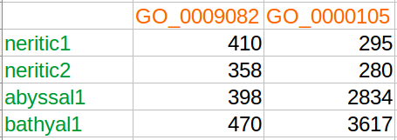
Subclasses of GO:biological process
variables
Subclasses of ENVO:marine benthic biome
objects
44
Notes:
When I do that, show the finding this is doing all these things. Solution discovers the subclasses of ENVO… I didn’t know where they fit, using knowledge rep for knowledge for data discovery, Subclasses subproperties, feed into R for analysis

Slide 45

Subclasses of GO:biological process
variables
Subclasses of ENVO:marine benthic biome
objects
ENVO: objects by GO:variables Principal Coordinate Analysis (PCoA)
45
Notes:
When I do that, show the finding this is doing all these things. Solution discovers the subclasses of ENVO… I didn’t know where they fit, using knowledge rep for knowledge for data discovery, Subclasses subproperties, feed into R for analysis

Slide 46
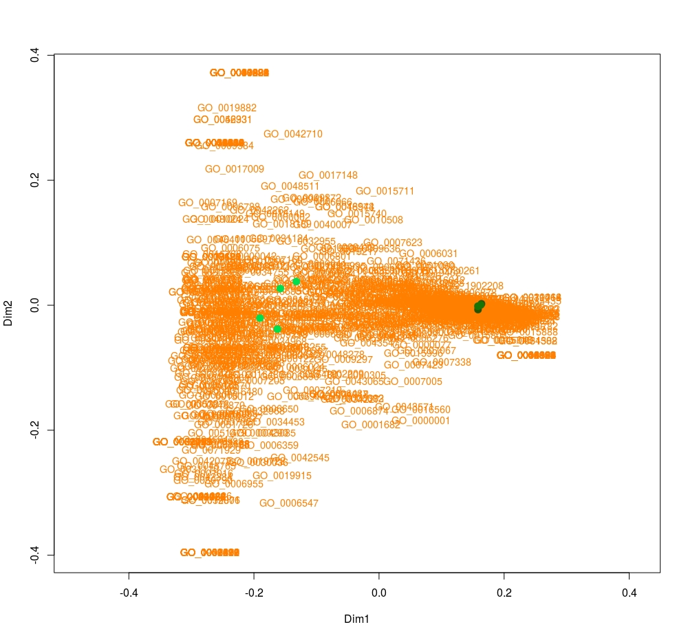
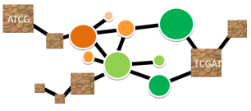
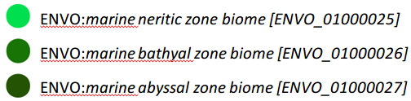
Q2) “What biological processes differentiate various types of marine benthic biomes?”
?
ENVO:marine neritic zone biome
GO:respiratory electron transport chain [GO_0022904]
GO:intracellular protein transport [GO_0006886]
GO:response to arsenic-containing substance [GO_0046685]
Notes:
46

Slide 47
Q2) “What biological processes differentiate various types of marine benthic biomes?”
?
ENVO: marine abyssal zone biome and ENVO: marine bathyal zone biome
GO:tyrosine biosynthetic process [GO_0006571]
GO:2’-deoxyribonucleotide metabolic process [GO_0009394]
GO:organic phosphonate metabolic process [GO_0019634]
Notes:
47

Slide 48
Q3) “What cellular amino acid biosynthetic processes differentiate marine benthic biomes?”
?
Notes:
48
*note this applies only for marine benthic biomes for which we have examples present in the dataholdings

Slide 49
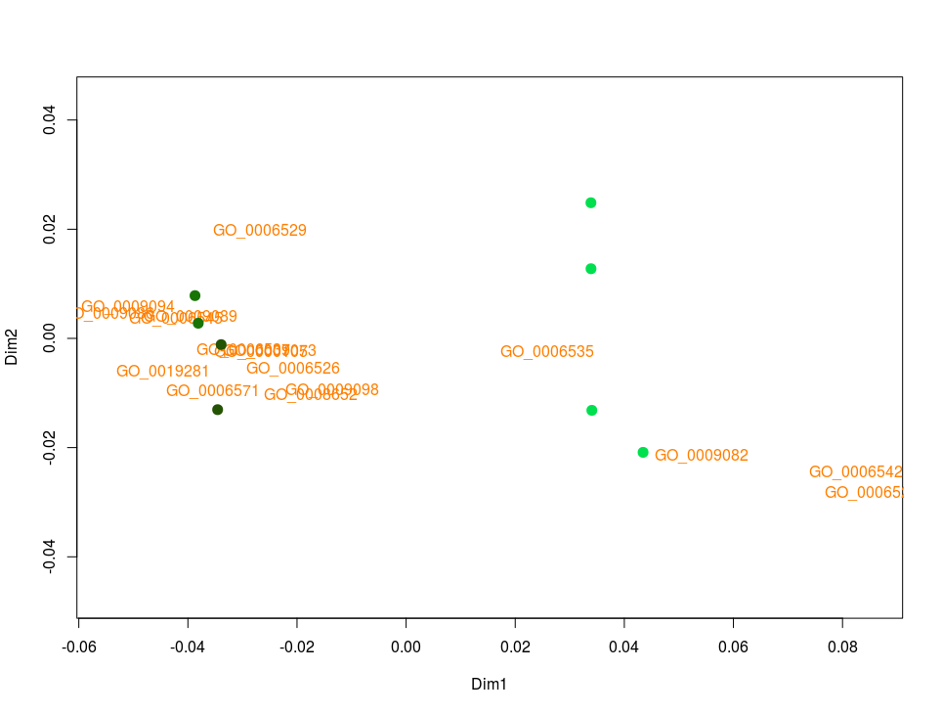
Q3) “What cellular amino acid biosynthetic processes differentiate marine benthic biomes?”
?
ENVO:marine neritic zone biome
GO:cysteine biosynthetic process from serine [GO_0006535]
GO:branched-chain amino acid biosynthetic process [GO_0009082]
GO:leucine biosynthetic process [GO_0009098]
Notes:
49

Slide 50
Q3) “What cellular amino acid biosynthetic processes differentiate marine benthic biomes?”
?
ENVO: marine abyssal zone biome and ENVO: marine bathyal zone biome
GO:lysine biosynthetic process via diaminopimelate [GO_0009089]
GO:glutamate biosynthetic process [GO_0006537]
GO:glycine biosynthetic process [GO_0006545]
Notes:
50

Slide 51
Q4) “What serine family amino acid biosynthetic processes differentiate marine benthic biomes?”
?
Notes:
51
*note this applies only for marine benthic biomes for which we have examples present in the dataholdings

Slide 52

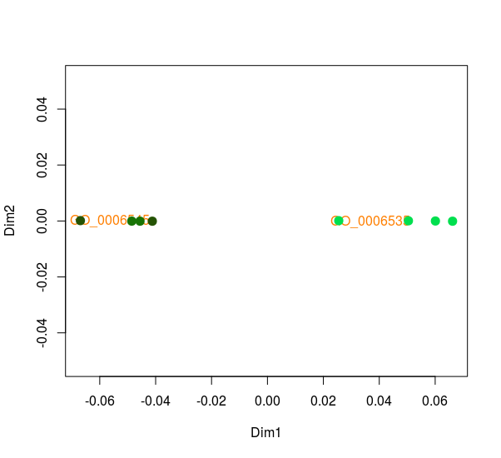
Q4) “What serine family amino acid biosynthetic processes differentiate marine benthic biomes?”
?
Notes:
52

Slide 53
Q4) “What serine family amino acid biosynthetic processes differentiate marine benthic biomes?”
?
ENVO:marine neritic zone biome
GO:cysteine biosynthetic process from serine [GO_0006535]
Notes:
53

Slide 54
Q4) “What serine family amino acid biosynthetic processes differentiate marine benthic biomes?”
?
ENVO:marine neritic zone biome
GO:cysteine biosynthetic process from serine [GO_0006535]
ENVO: marine abyssal zone biome and ENVO: marine bathyal zone biome
GO:glycine biosynthetic processes [GO_0006545]
Notes:
54

Slide 55
Overview and outlook
Capture expert knowledge
ontologies
Standardize data
interoperable
machine-accessible
Enable machine-analysis of large datasets
interconnect environmental and genomic data
search for signals worth investigating manually
55
Notes:
Disscuss, caviat not a full dataset
Obvious citations find a compact citation for the format to show citations.

Slide 56

Acknowledgments
HGF-MPG Joint Research Group for Deep-Sea Ecology and Technology group
Antje Boetius (AWI)
Pier Luigi Buttigieg (AWI)
Josephine Rapp (AWI, MPI Bremen)
MPI Bremen
David Probandt (MPI Bremen)
Matthew Schechter (MPI Bremen)
External Collaborators
Ruth Duerr (National Snow and Ice Data Center)
Ramona Walls (CyVerse, U Arizona)
Slides partially adapted from the presentation: Ontological support for the EBVs, courtesy of Pier Luigi Buttigieg https://creativecommons.org/licenses/by/2.0/legalcode
Notes:
56

Slide 57


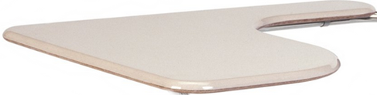


questions?
Code and documentation available from: https://github.com/kaiiam/kblumberg_masters_thesis/
Notes:
57
Put polar bear asking a question or ibm watson vs jeopardy guy, some
Code and documentation available here https://github.com/kaiiam/kblumberg_masters_thesis/

Slide 58
Supplemental slides
Notes:
58

Slide 59
Competency questions
What are the relative proportions of oxidation-reduction process genes in various types of marine biomes?
What are the relative proportions of vitamin biosynthetic process genes in various types of marine biomes?
What genomic features may help to explain the differences in riboflavin proportions between deep and shallow marine benthic biomes?
What biological processes differentiate various types of marine benthic biomes?
What cellular amino acid biosynthetic processes differentiate various types of marine benthic biomes?
What serine family amino acid biosynthetic processes differentiate various types of marine benthic biomes?
What data about environmental factors with the potential to influence the dynamics of a sea-ice associated phytoplankton community could be collected using an ontology?
Is the ontology knowledge graph of the envoPolar subset sufficiently well connected to be able to lead researchers to new knowledge via unstated linkages to identified knowledge?
What are all the papers which reference any data set, which is about a part of a marine biome?
How well do the Environment Ontology and the Environment Ontology Polar subset connect authors of terms to the information they helped to encode?
Are ontology knowledge representations resilient to the input of new information which may contain definitional discrepancies?
What percentages of data items discovered to be about participants in sea ice formation processes would be retrievable if changes were to be made to the underlying semantic models used by OBO ontologies, such as not using hierarchical subclass structures to represent knowledge, or not using structured relations from the Relations Ontology?
What level of querying expertise is required to access the various types of data contained in the example polar datastore?
Does the inclusion of novel expert knowledge about phenomena relating to plankton ecology into the ENVO knowledge graph aid to better understand the interconnections of such phenomena?
Notes:
Aims of thesis, what do I mean by fit for purpose, to navigate the knowledge and dataspace, in order to do that in semantic research test ccs can it do this …
Show list of cc tested form may angles, highlight the ones I’m going to talk about. Another slide for the ccs I address, go from section with the cc in bold. As table of contents.

Slide 60
Semantic data-annotation
A: a CSV data column labeled Chlorophyll A
B: BFO:part of [BFO_0000050] some OBCS:data matrix [OBCS_0000120]
path:ChlorophyllA a owl:NamedIndividual ;
a [rdf:type owl:Class ;
owl:equivalentClass [rdf:type owl:Class ;
owl:intersectionOf ([rdf:type owl:Restriction ;
owl:onProperty obo:BFO_0000050 ;
owl:someValuesFrom obo:OBCS_0000120
]
[rdf:type owl:Restriction ;
owl:onProperty obo:IAO_0000136 ;
owl:someValuesFrom [rdf:type owl:Class ;
owl:intersectionOf (obo:PATO_0000033
[rdf:type owl:Restriction ;
owl:onProperty obo:RO_0000052 ;
owl:someValuesFrom [rdf:type owl:Class ;
owl:intersectionOf (obo:CHEBI_18230
[rdf:type owl:Restriction ;
owl:onProperty obo:BFO_0000050 ;
owl:someValuesFrom obo:ENVO_00002149
]
)
]
]
)
]
]
)
]
] .
C: IAO:is about [IAO_0000136]
D: PATO:concentration of [PATO_0000033]
E: RO:inheres in [RO_0000052]
F: CHEBI:chlorophyll a [CHEBI_18230]
G: BFO:part of [RO_0000050]
H: in ENVO:sea water [ENVO_00002149]

Slide 61
Scientific method in semantic research
Make observations about existing knowledge
Can encoded knowledge be used to gather information and data?
Observations
Hypothesis
Gather and encode into an ontology
Formalize as a testable competency question
Methods
Collect both data and knowledge graphs
Data collection
Data analysis
Test interaction of knowledge graph and data sets
Analyze interaction of collected data and knowledge
conclusions

Slide 62
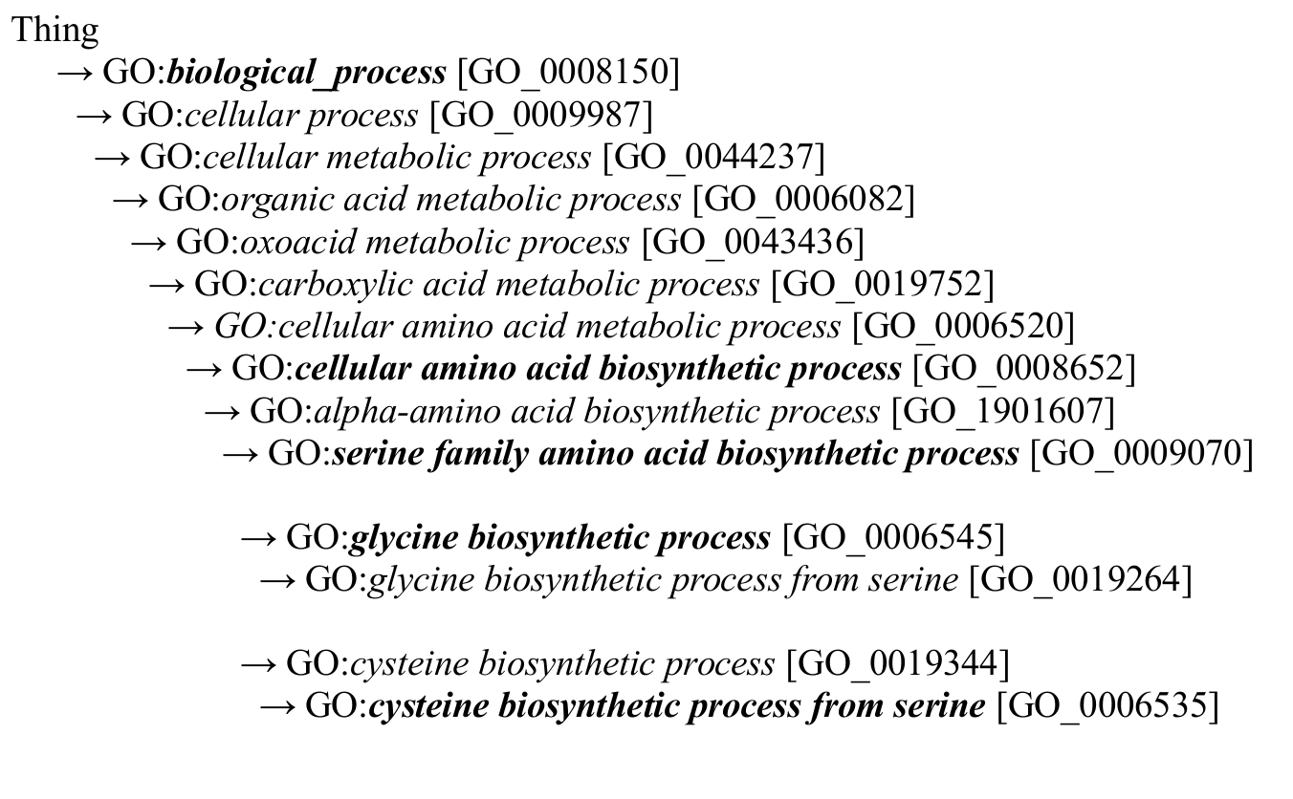
Notes:
62

Slide 63
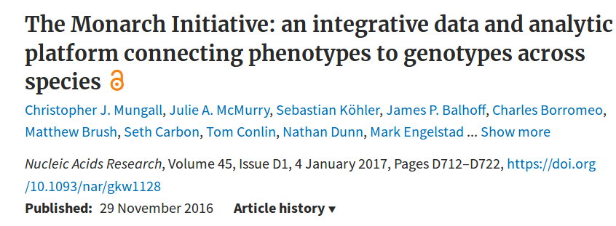
The Monarch Initiative uses an ontology-based strategy to integrate genotype–phenotype data from various sources and species, enabling users to explore phenotypic and genotypic relationships across species
Notes:
63

Slide 64



A: query questions:
B: user expertise:
C: How much of the total data did the users retrieve?
Basic user
5 %
Get data about:
‘sea ice’ and ‘thickness’
Intermediate user
35 %
‘part of’ a ‘marine biome’
…
Advanced user
97 %
D: Total data.

Slide 65
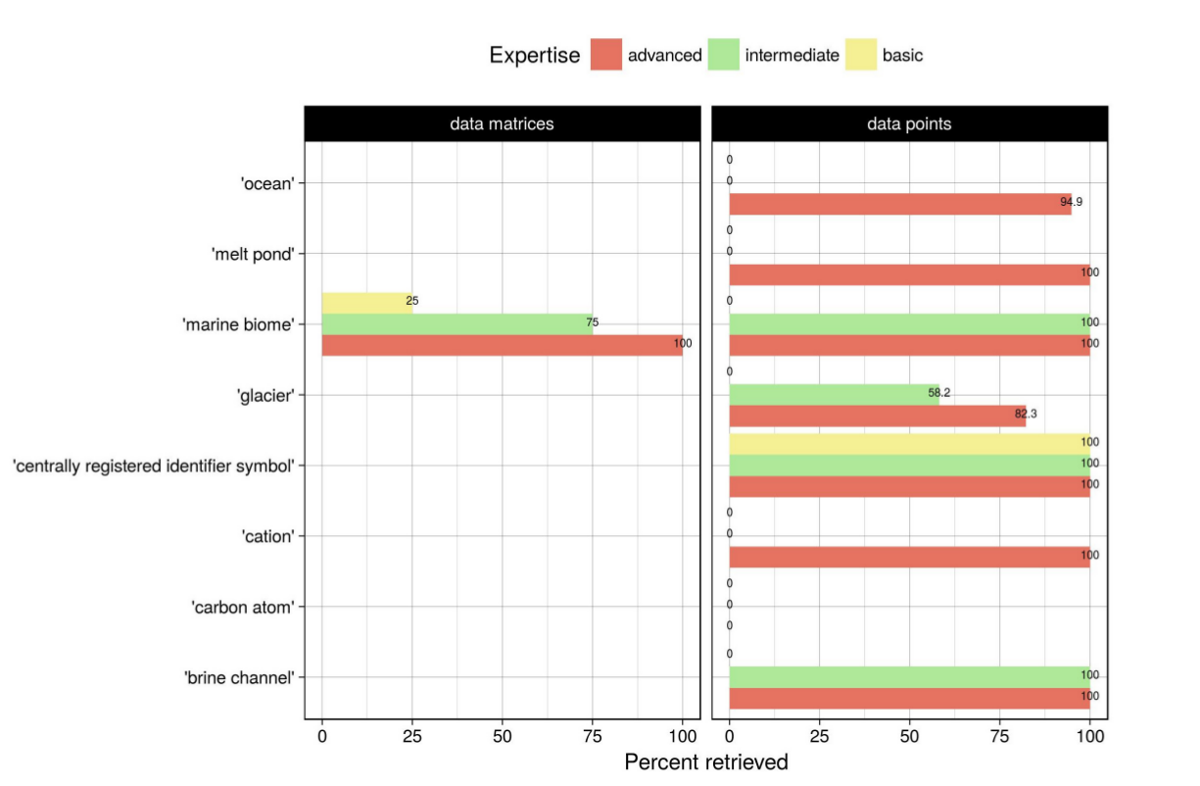
“What level of querying expertise is required to mobilize ‘well’ annotated data?”
Query for datasets and dataset columns about parts of X
Notes:
65

Slide 66
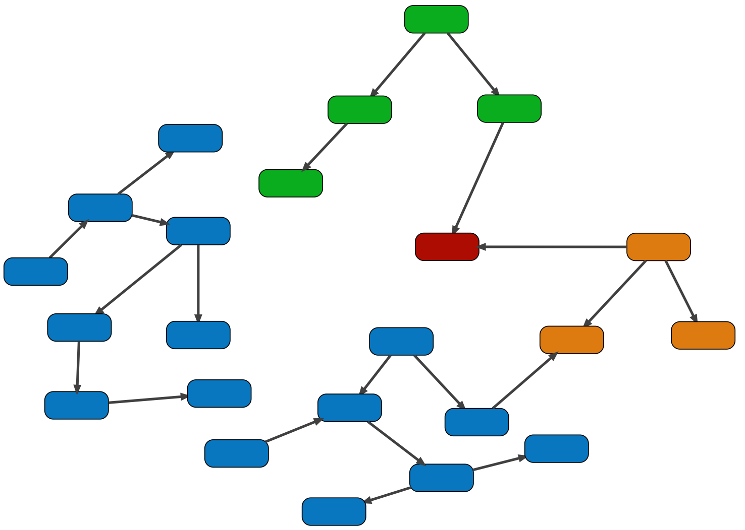
A: query
B: knowledge graph:
SELECT ?X
FROM …
WHERE {
?X subclassOf inputClass
?X partOf Y
}
inputClass
subclassOf
subclassOf
partOf
?X
Y
C: find ?X
D: return result X
X

Slide 67
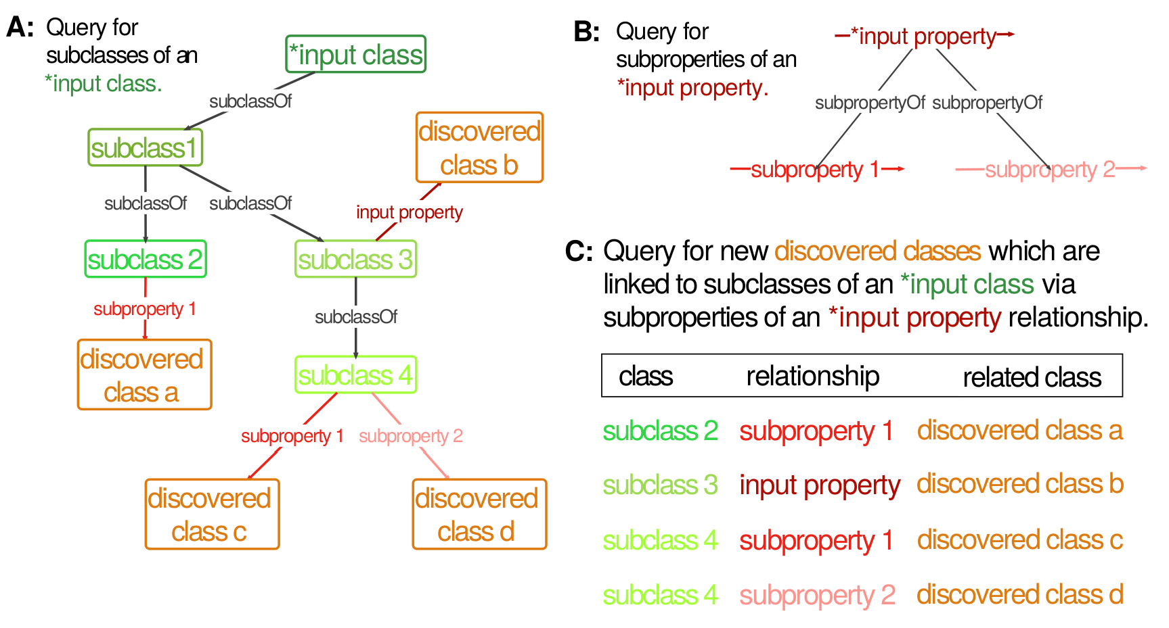

Slide 68
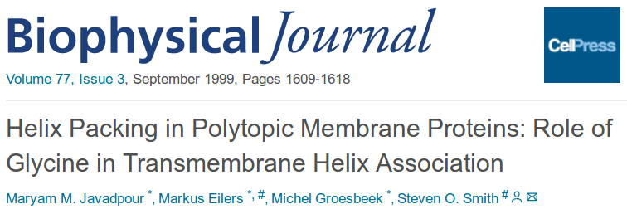
Glycine can fit into hydrophilic or hydrophobic environments, due to its minimal side chain of only one hydrogen atom.
In contrast to soluble proteins where glycine is a noted helix breaker
The picture that emerges is one where glycine residues serve as molecular notches for orienting multiple helices in a folded protein complex.

Slide 69
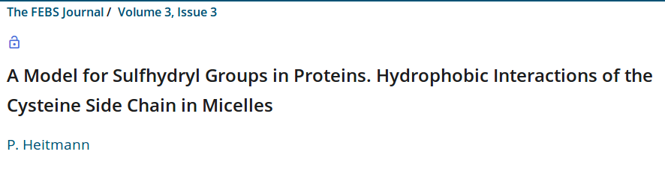
Cysteine a hydrophilic amino acid
The cysteine side chain has been shown to stabilize hydrophobic interactions in micelles to a greater degree than the side chain in the non-polar amino acid glycine and the polar amino acid serine.

Slide 70
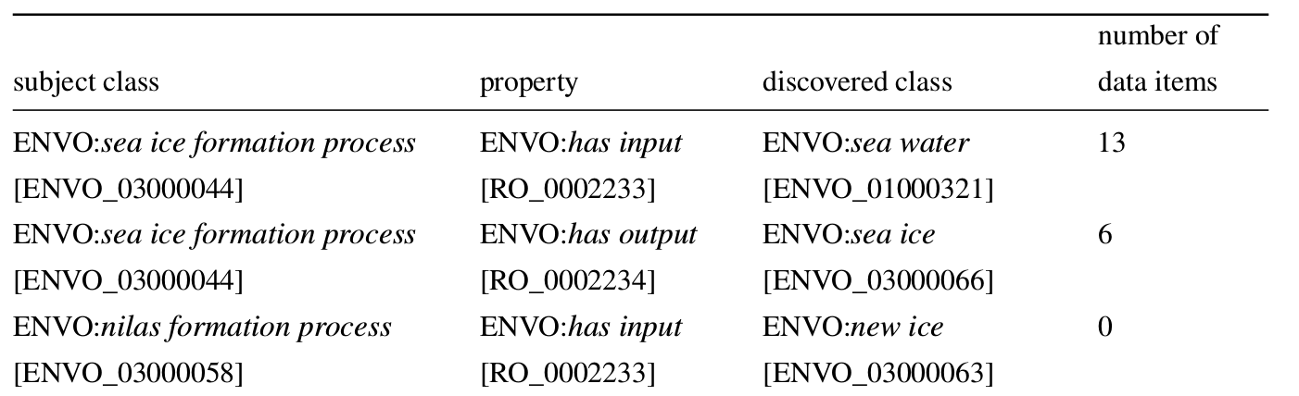

Slide 71
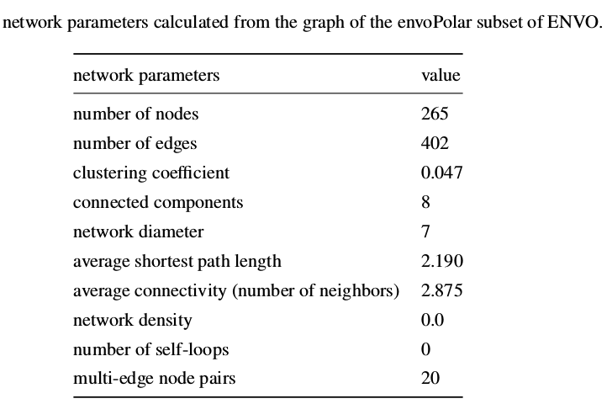
“Are ontology terms sufficiently well connected to lead researchers from data about X to data about Y?”
Notes:
71

Slide 72
“Are ontology terms sufficiently well connected to lead researchers from data about X to data about Y?”
Average node is connected to 3 other nodes and is only 2 steps away from most other nodes
Notes:
72

Slide 73
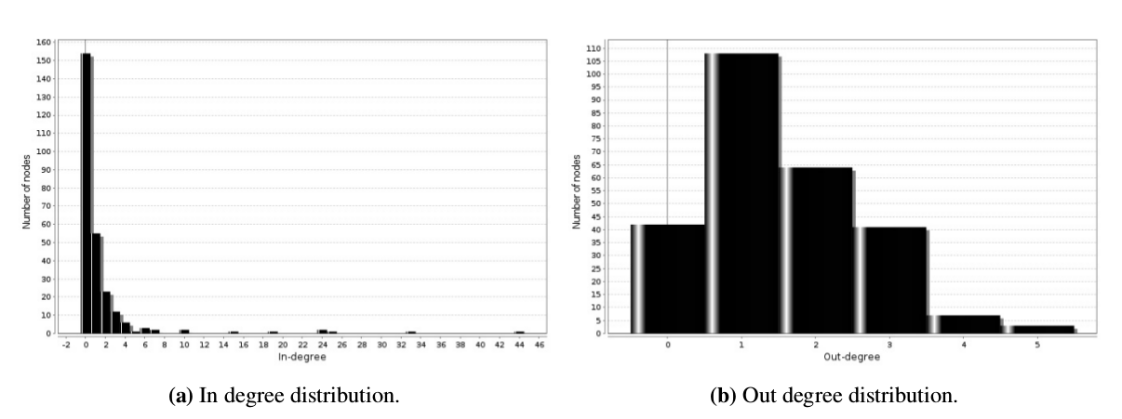
“Are ontology terms sufficiently well connected to lead researchers from data about X to data about Y?”
Notes:
73

Slide 74
“Are ontology terms sufficiently well connected to lead researchers from data about X to data about Y?”
Most nodes are only pointed to by 1 other node, some nodes are pointed to by many nodes
Notes:
74

Slide 75
“Are ontology terms sufficiently well connected to lead researchers from data about X to data about Y?”
Most nodes only point to by 1 other node. At max a node can only point to 5 others.
Notes:
75

Slide 76
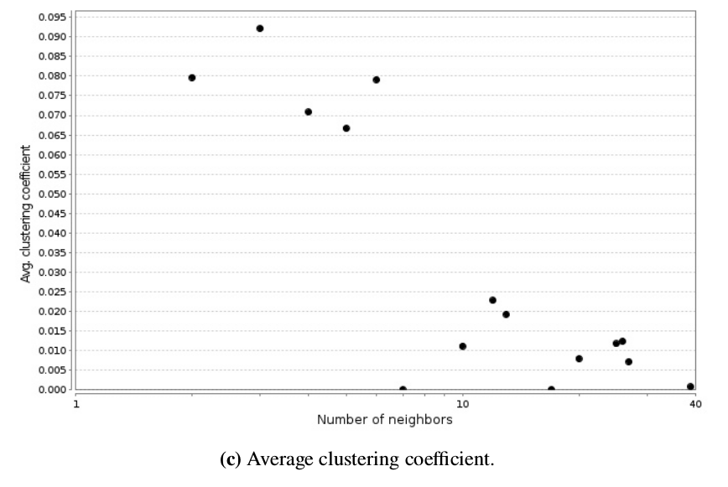
“Are ontology terms sufficiently well connected to lead researchers from data about X to data about Y?”
Notes:
76

Slide 77
“Are ontology terms sufficiently well connected to lead researchers from data about X to data about Y?”
Nodes low down in the hierarchy are not directly connected to their many neighbors
Notes:
77

Slide 78
“Are ontology terms sufficiently well connected to lead researchers from data about X to data about Y?”
Nodes higher up in the hierarchy are very well connected but have less neighbors
Notes:
78

Slide 79
“Are ontology terms sufficiently well connected to lead researchers from data about X to data about Y?”
Conclusion: Nodes are organized such that the most nodes are connected only to a local hub which is well connected to other hubs
Notes:
79

